Slide 1
Object Oriented Programming
Week 8
Abeer GAUHER
Email: abeer.gauher@nu.edu.pk
Office: CS BASEMENT 2, Office number 17

Slide 2
Introduction to Friend Functions
Non-member functions of a class will not have access to the private data of another class.
Situations where we want two classes to share some functions and the data members.
Make the function a friend of these classes, and that will enable the function to access the private and protected data members of the classes.

Slide 3
What is a friend function?
A friend function is a function that is specified outside a class but has the ability to access the class members’ protected and private data.
A friend can be a member’s function, function template, or function, or a class or class template, in which case the entire class and all of its members are friends.

Slide 4
Why do we need friend functions?
In special cases when a class’s private data needs to be accessed directly without using objects of that class, we need friend functions.
For instance, let’s consider two classes: Director and Doctor.
We may want the function salary( ) to operate on the objects of both these classes.
The function does not need to be a member of either of the classes.

Slide 5
Special features of friend functions
A friend function does not fall within the scope of the class for which it was declared as a friend. Hence, functionality is not limited to one class.
Friend functions are not called using objects of the class because they are not within the class’s scope.
Without the help of any object, the friend function can be invoked like a normal member function.
Friend functions can use objects of the class as arguments.
Friend function cannot explicitly access member names directly. Every member name has to use the object’s name and dot operator..

Slide 6
Syntax of friend functions
class className{
// Other Declarations
friend returnType functionName(arg list);};
The friend function should be declared inside the class whose private and protected members are to be accessed.
friend is a keyword to denote that this function is a friend function.
returnType is the function’s return type.
functionName is the name of the function being made a friend of the class.
arg list is the arguments that are passed.
The friend function definition is found outside the class like a normal member function. The friend function is not defined using the friend keyword or use the scope resolution operator:: as it is not a member of the class in which it has been declared.

Slide 7
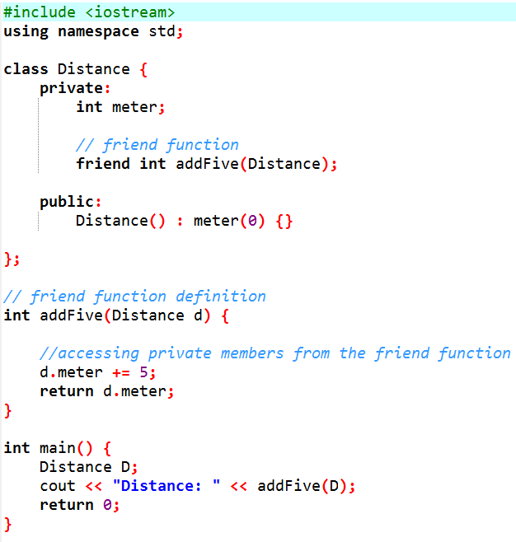
Friend function
Here, addFive() is a friend function that can access both private and public data members.
A more meaningful use would be operating on objects of two different classes.
That's when the friend function can be very helpful.

Slide 8
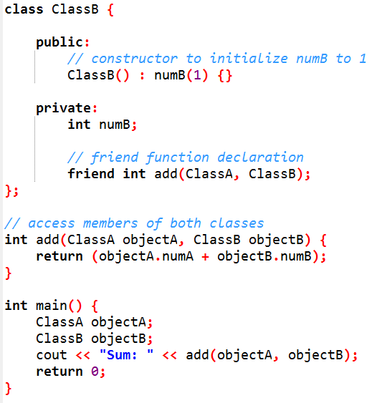
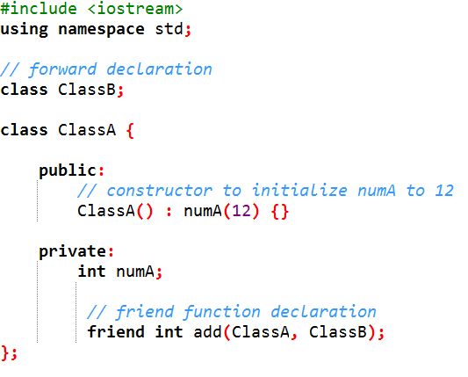
Friend function
ClassA and ClassB have declared add() as a friend function. Thus, this function can access private data of both classes.
One thing to notice here is the friend function inside ClassA is using the ClassB. However, we haven't defined ClassB at this point.
For this to work, we need a forward declaration of ClassB in our program.

Slide 9
Friend function
Here, addFive() is a friend function that can access both private and public data members.
A more meaningful use would be operating on objects of two different classes.
That's when the friend function can be very helpful.

Slide 10
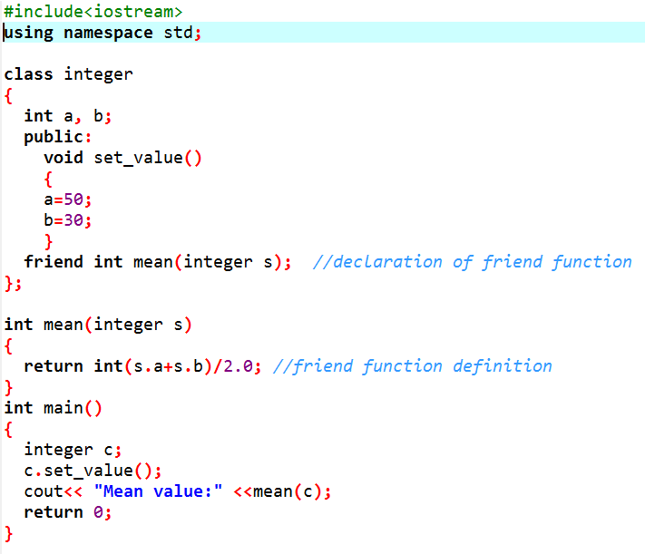
Friend function

Slide 11
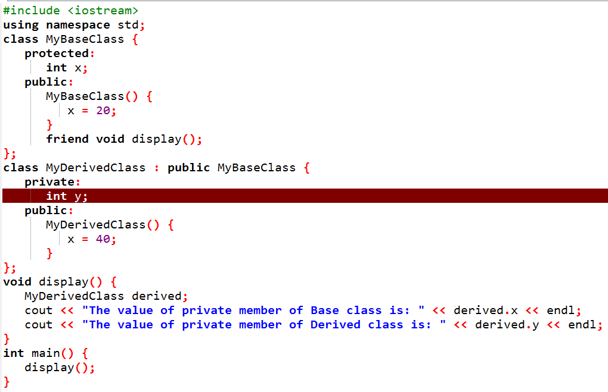

Friend function
Friend functions are never inherited.
In this example, the friend function is trying to access the private variable of MyDerivedClass which is not possible.

Slide 12
Friend class
We can also use a friend Class in C++ using the friend keyword. For example,
class ClassB;
class ClassA {
// ClassB is a friend class of ClassA
friend class ClassB;
... .. ...
}
class ClassB {
... .. ...
}
When a class is declared a friend class, all the member functions of the friend class become friend functions.
Since ClassB is a friend class, we can access all members of ClassA from inside ClassB.
However, we cannot access members of ClassB from inside ClassA. It is because friend relation in C++ is only granted, not taken.

Slide 13
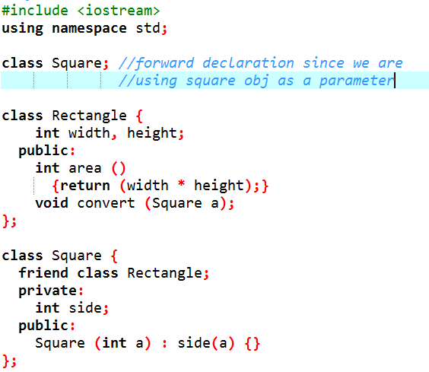
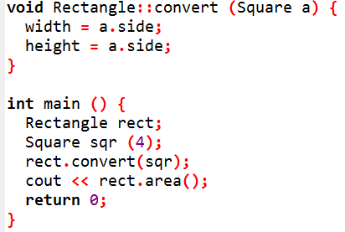
Friend class
Similar to friend functions, a friend class is a class whose members have access to the private or protected members of another class.

Slide 14
Friend class
Class Rectangle is a friend of class Square allowing Rectangle's member functions to access private and protected members of Square. More concretely, Rectangle accesses the member variable Square::side, which describes the side of the square.
At the beginning of the program, there is an empty declaration of class Square. This is necessary because class Rectangle uses Square (as a parameter in member convert), and Square uses Rectangle (declaring it a friend).
Rectangle is considered a friend class by Square, but Square is not considered a friend by Rectangle. Therefore, the member functions of Rectangle can access the protected and private members of Square but not the other way around. Of course, Square could also be declared friend of Rectangle, if needed, granting such an access.

Slide 15
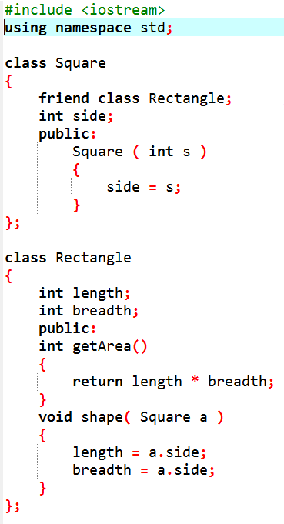
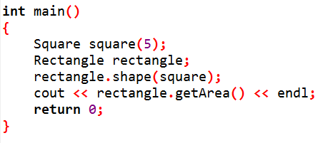
Friend class
Since we are not using Rectangle object in the square class, then forward declaration is not important.
Rectangle as a friend class of Square. All the functions of Rectangle can directly access any private member of Square.
In the main function, the first statement created an object 'square' of the class Square.
The second statement in the main function created an object 'rectangle' of the class Rectangle.
Rectangle' called the function shape() with the object of the class Square passed as its argument. In the 'shape()' function, the value of 'side' (private data member of Square) was assigned to length and breadth. The fourth statement called the function 'getArea' of the class Rectangle.

